Slide 1
DDS For Live Session
UNIT 1

Slide 2
Flow of Live Session
Introductions (15 min)
Syllabus Questions and Brief Overview (10 min)
Data Science News of the Week (DSNOW) (10 min)
DSNOW drawing for the semester (2 min)
Break Out 2 – CLT (15 min)
Break Out 1 – T-Test (15 min)

Slide 3
Oral Exam
I will provide a list of questions to study throughout the course.
Conducted on Zoom
The student chooses a question and I will choose the other.
There will be follow-up questions.
Typically lasts about 15 to 20 minutes per student.
Students must pass the oral exam to pass the course.
If a student does not pass the first time, they can take it up to 3 more times.

Slide 4
ChatGPT / Gen AI Policy
In this class, default to doing the exercises without ChatGPT.
Only use ChatGPT / Gen AI when directed in the FLS.
Never turn in ChatGPT generated code in this class unless it is instructed to do so in the problem.

Slide 5
Data Science News of the Week!

Slide 6
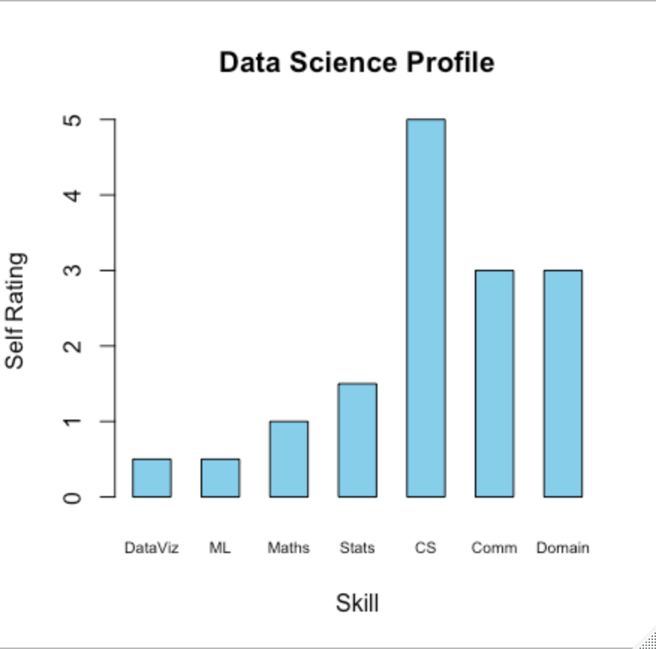
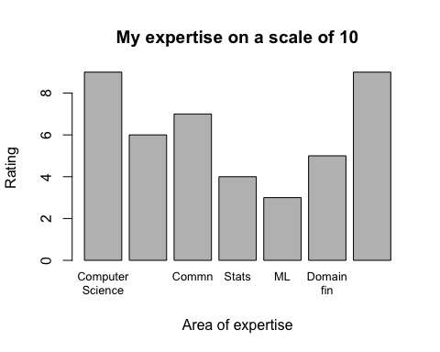
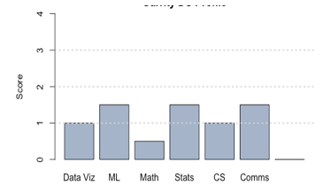
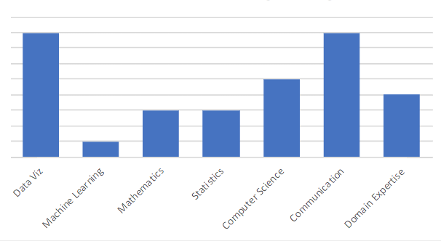
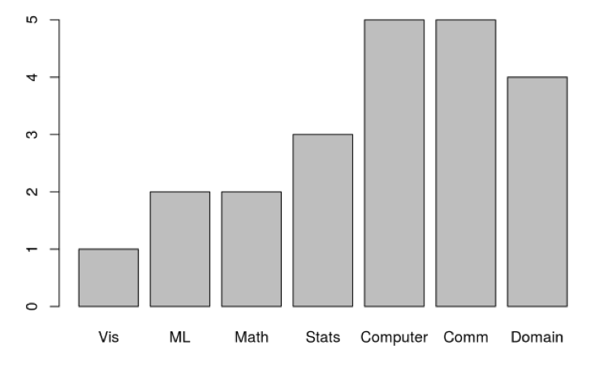
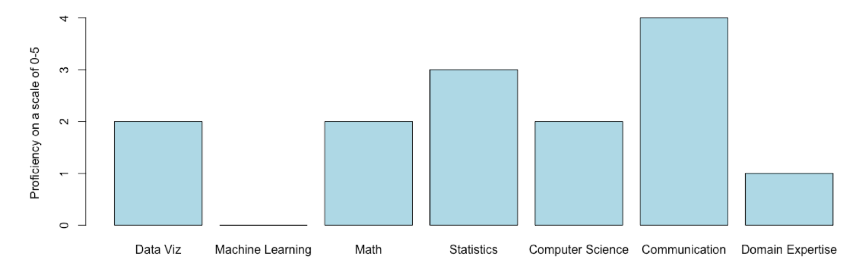
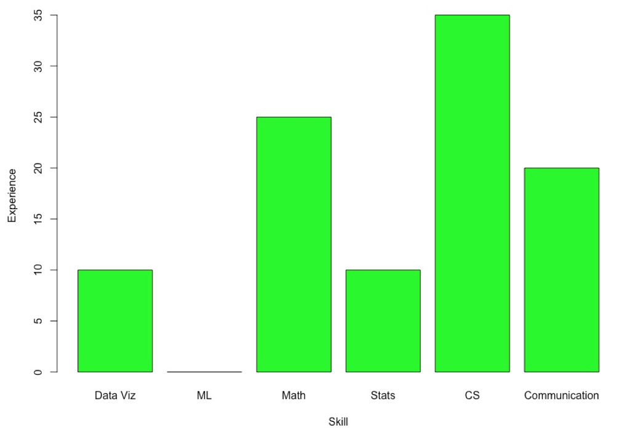
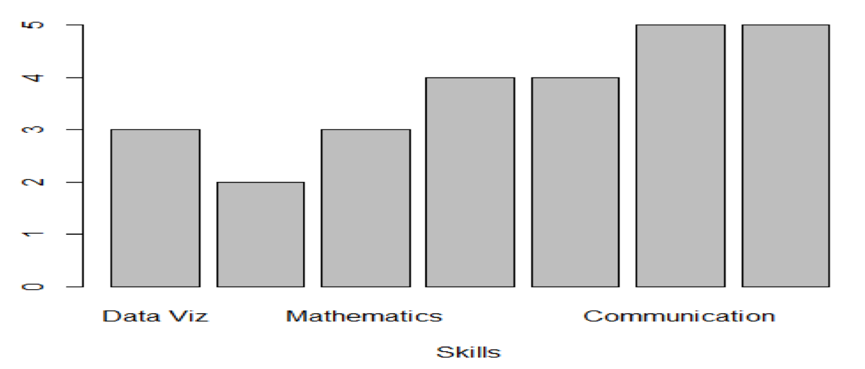
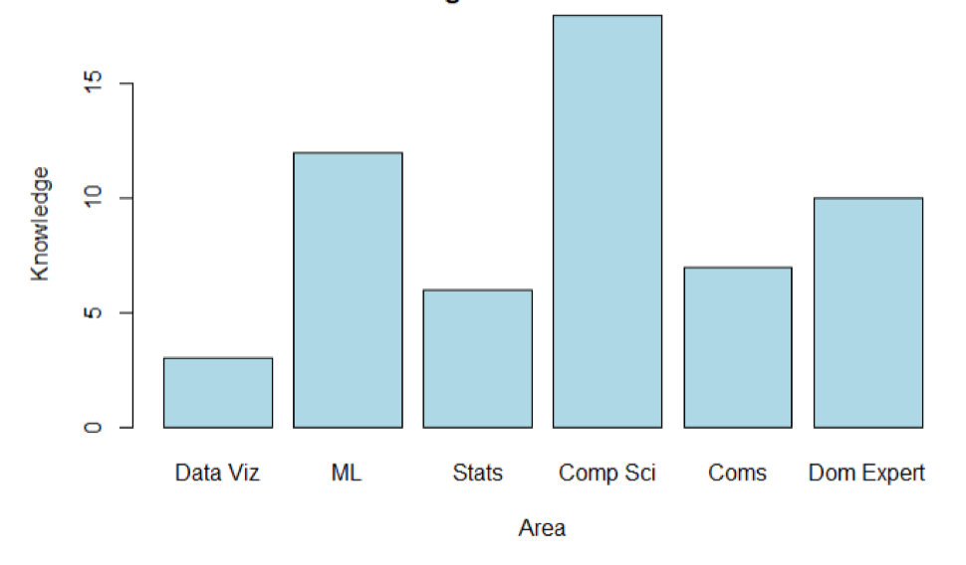
Data Science Profiles!

Slide 7
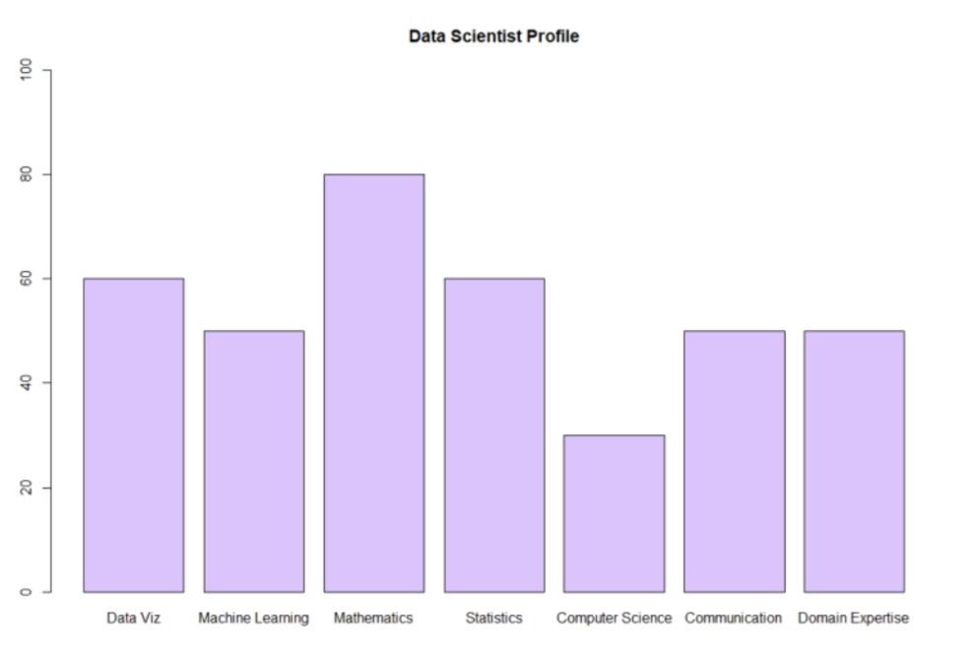
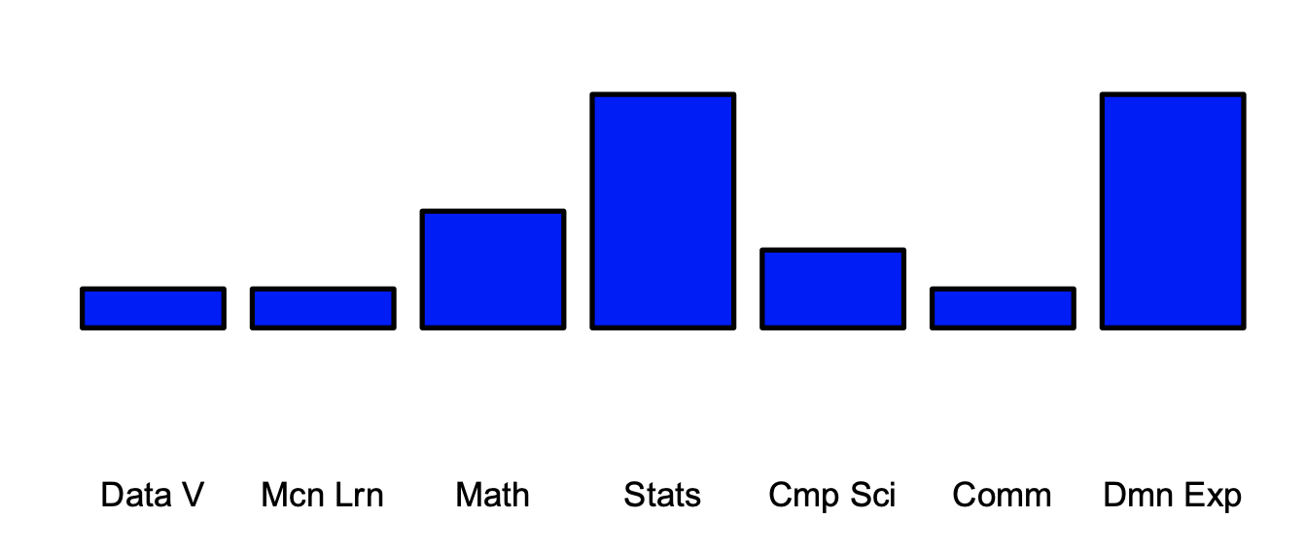
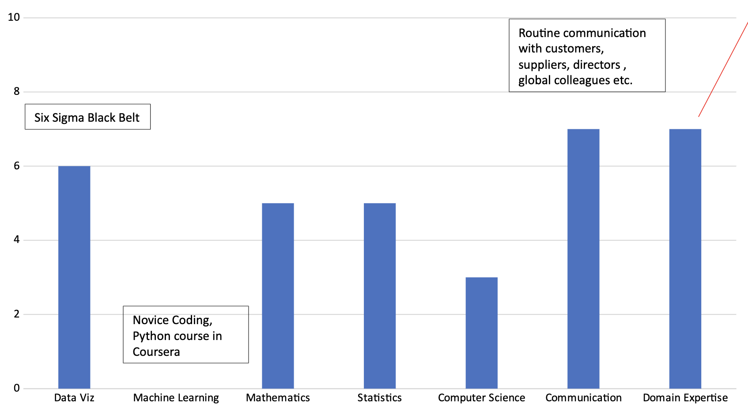
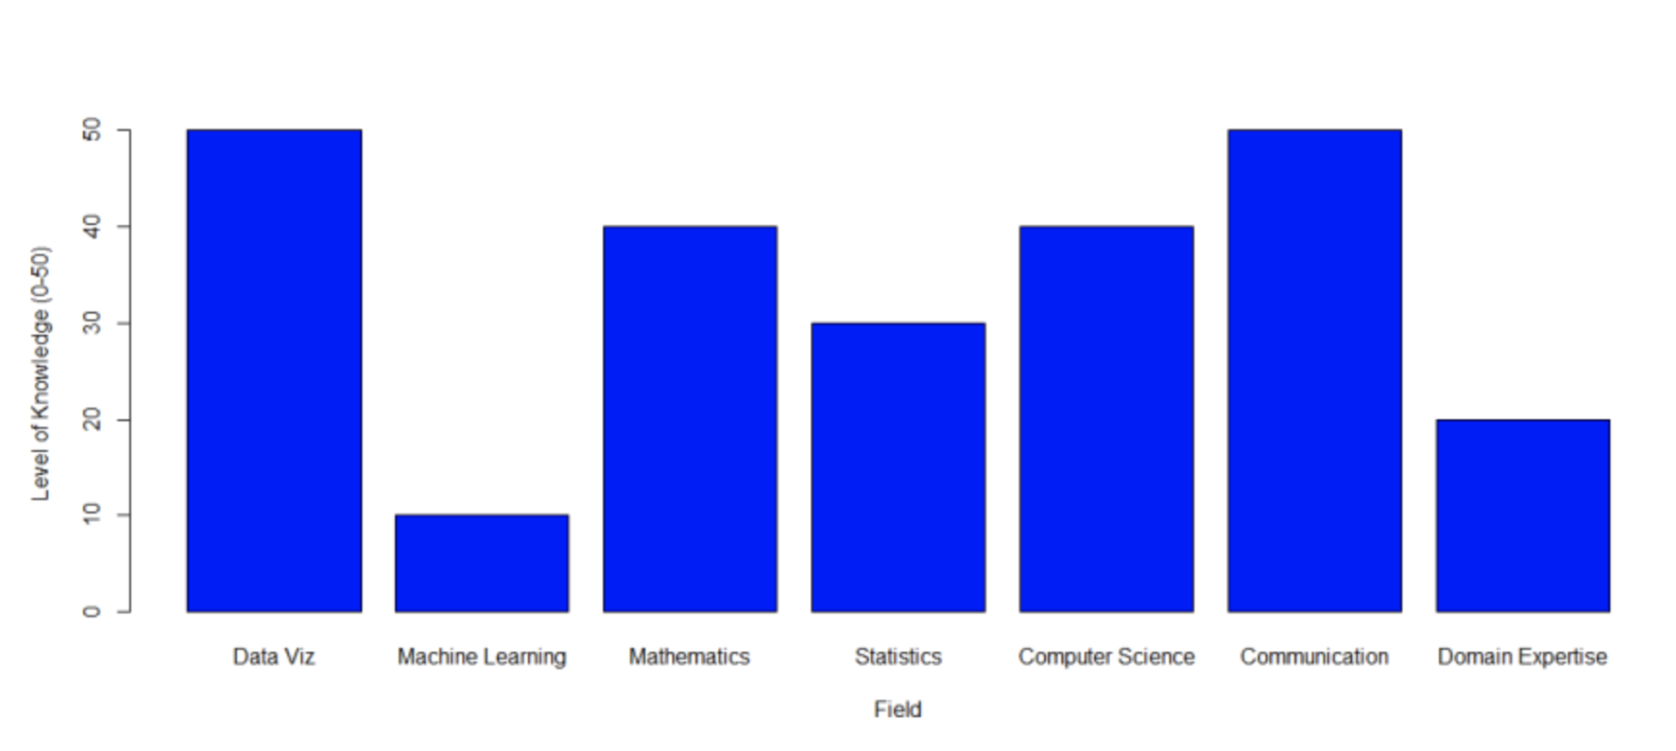
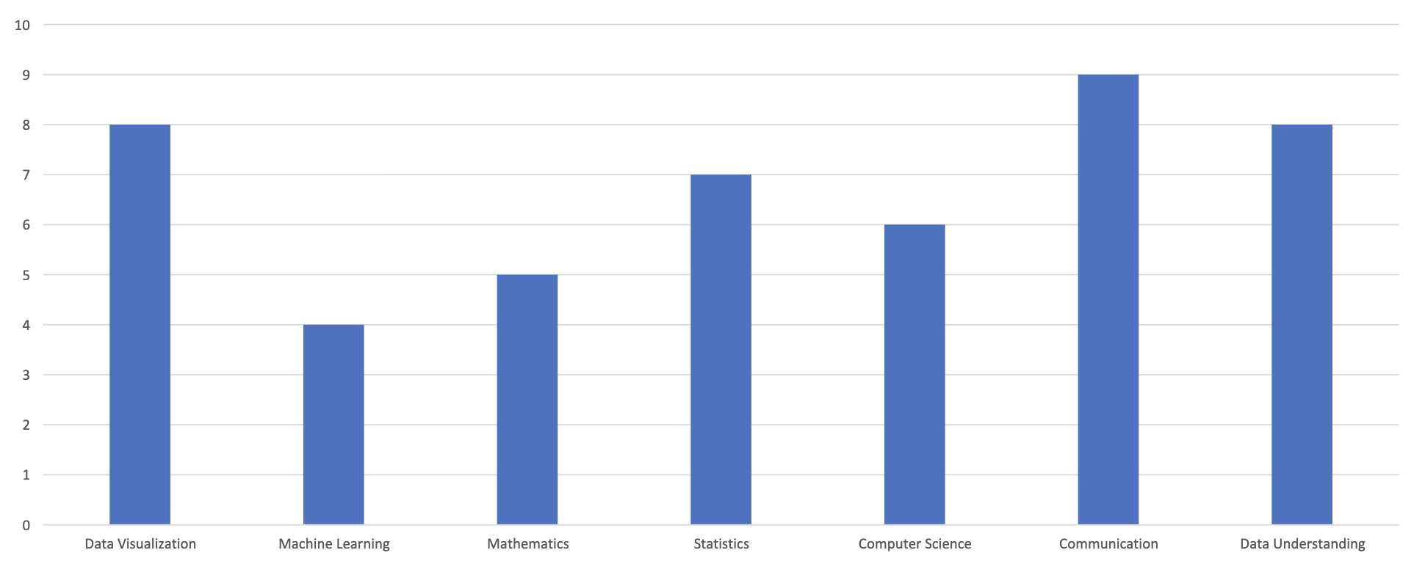
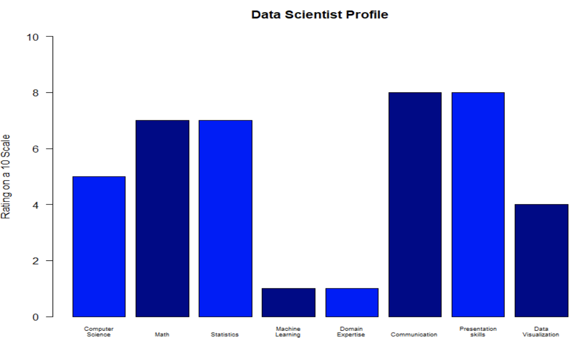
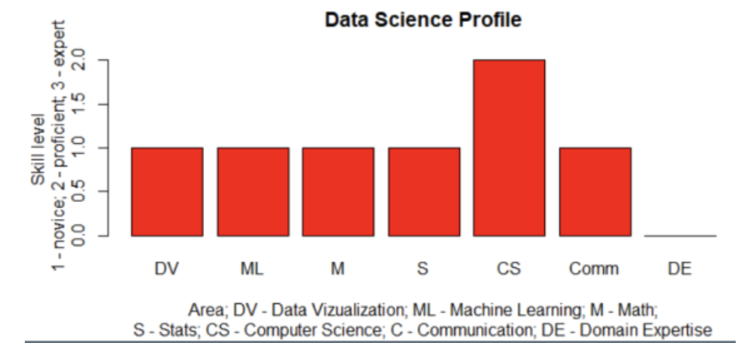
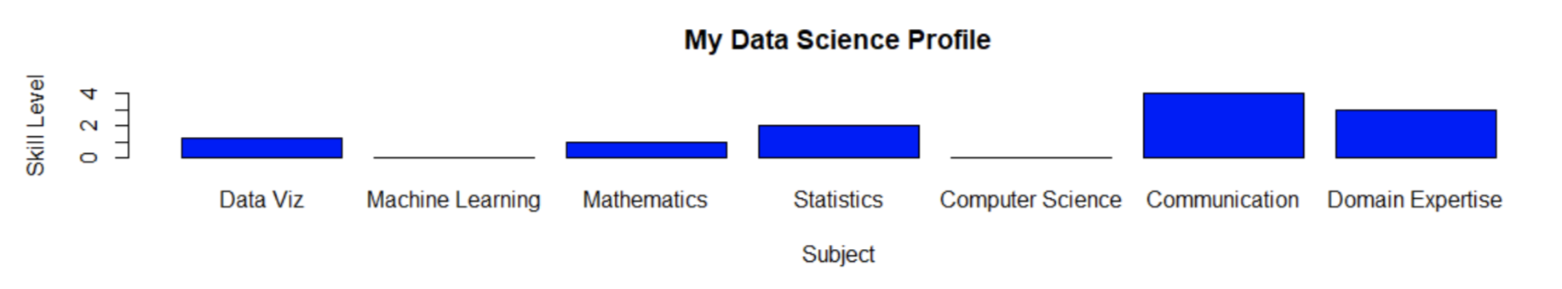
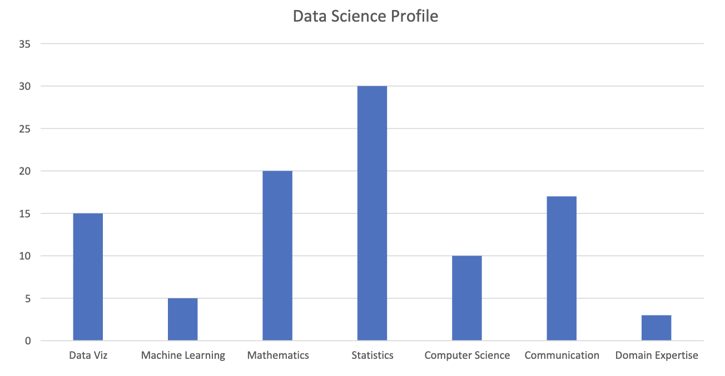
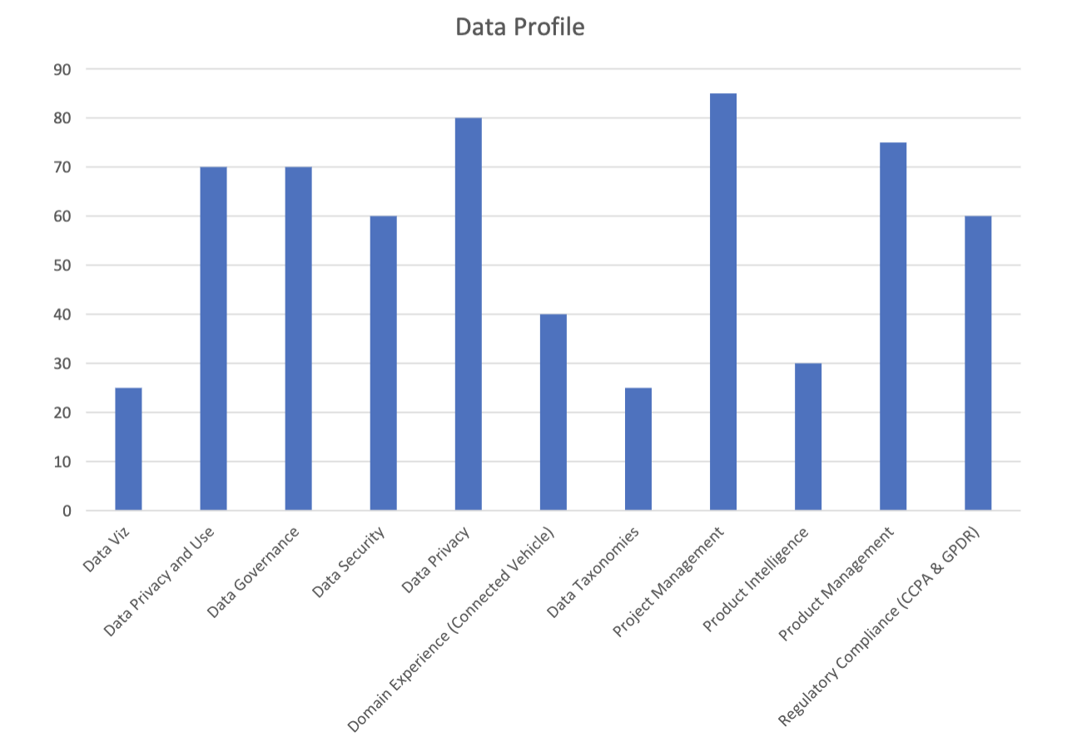
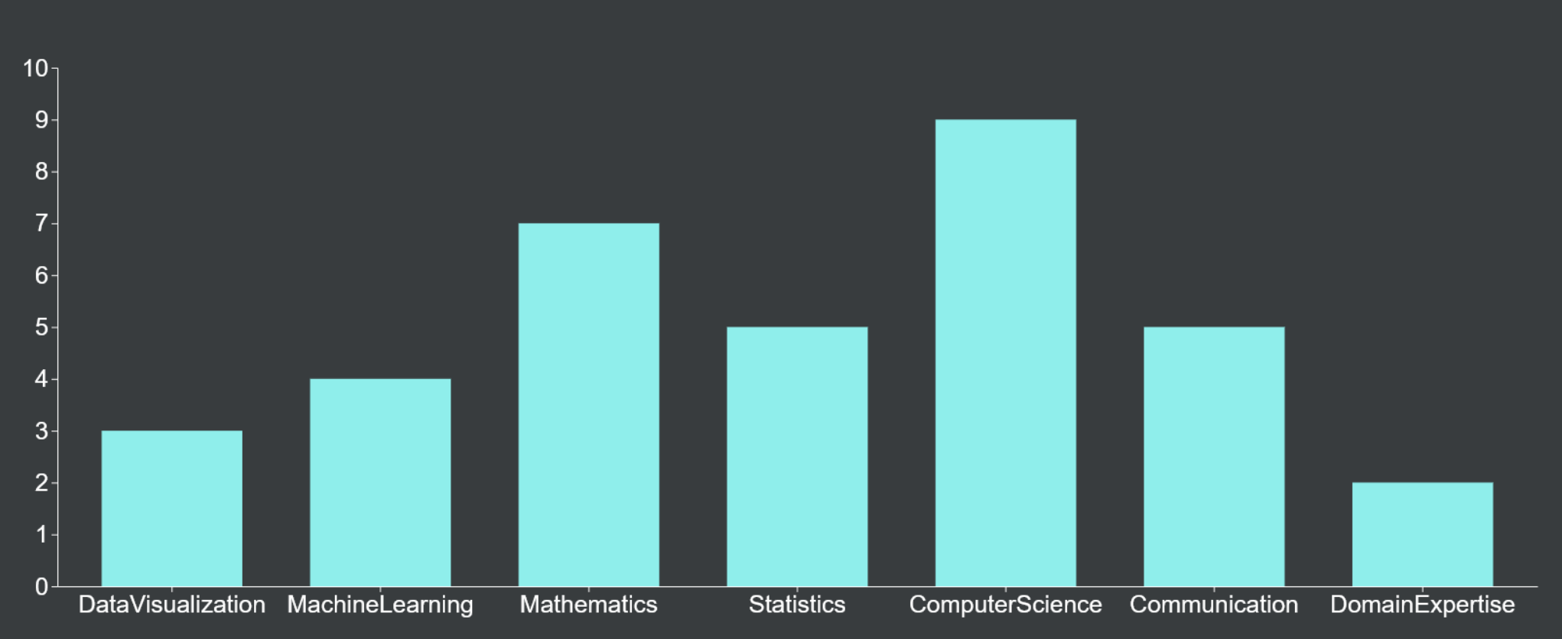
Our Data Science Profiles!

Slide 8
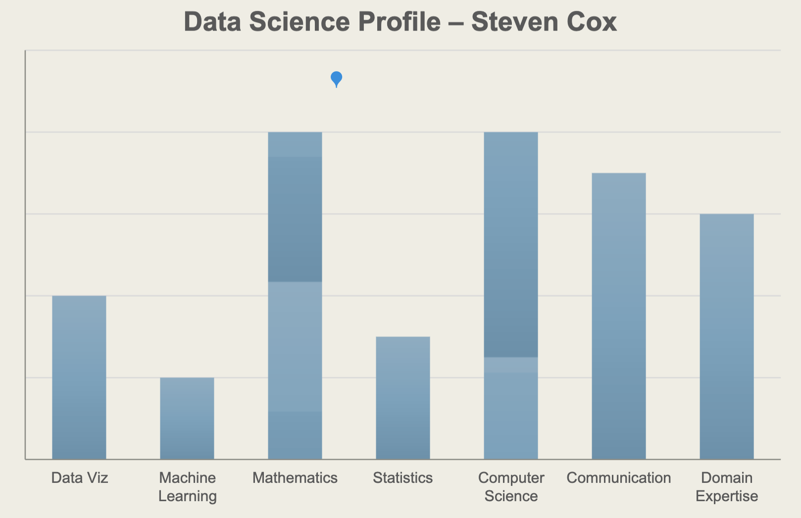
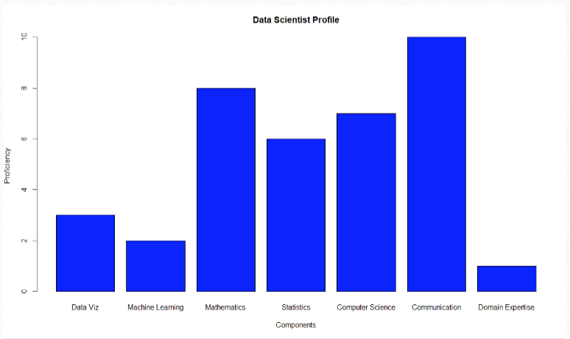
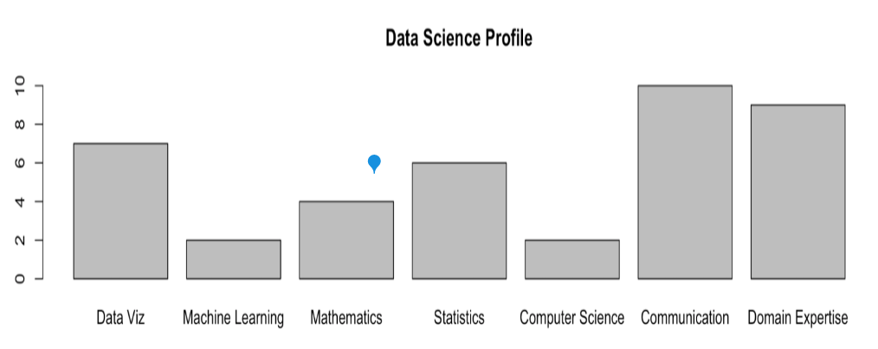
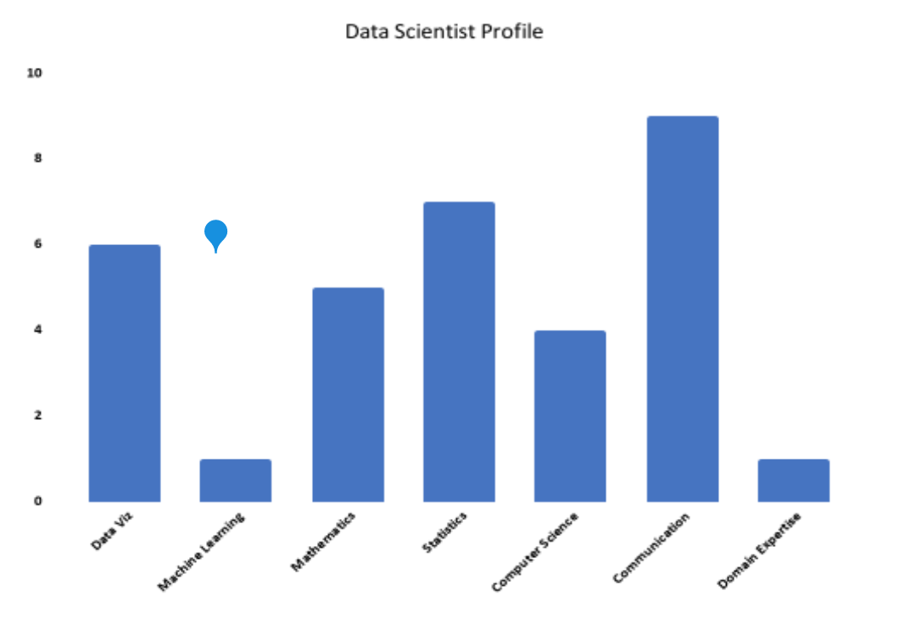
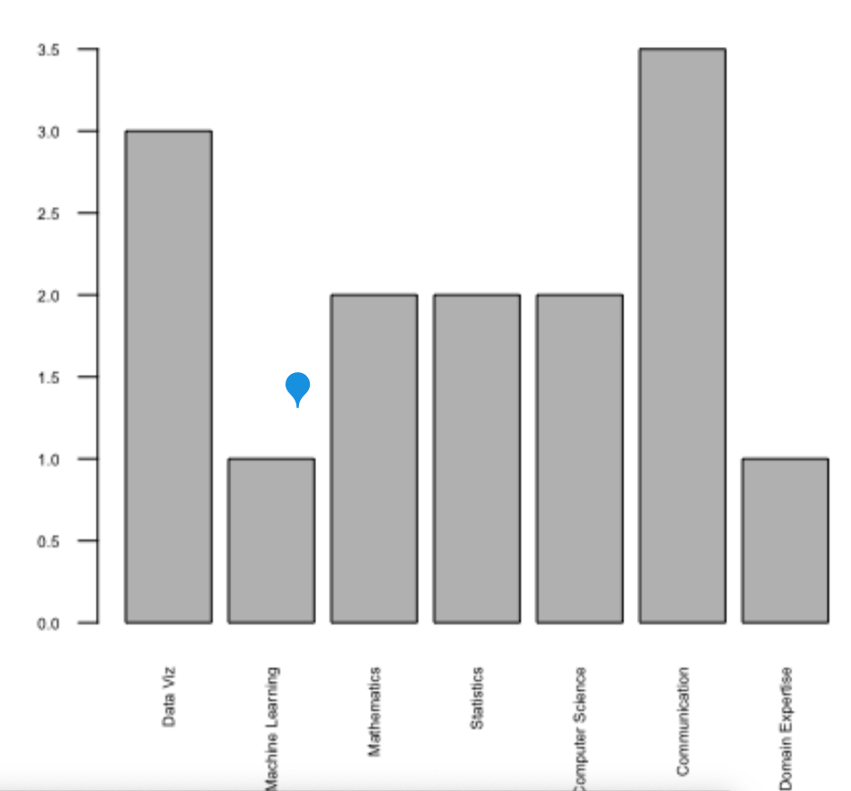
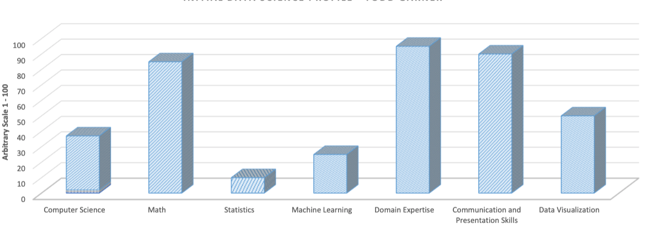
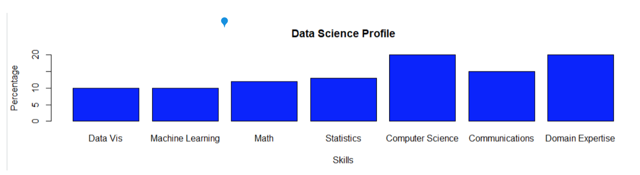
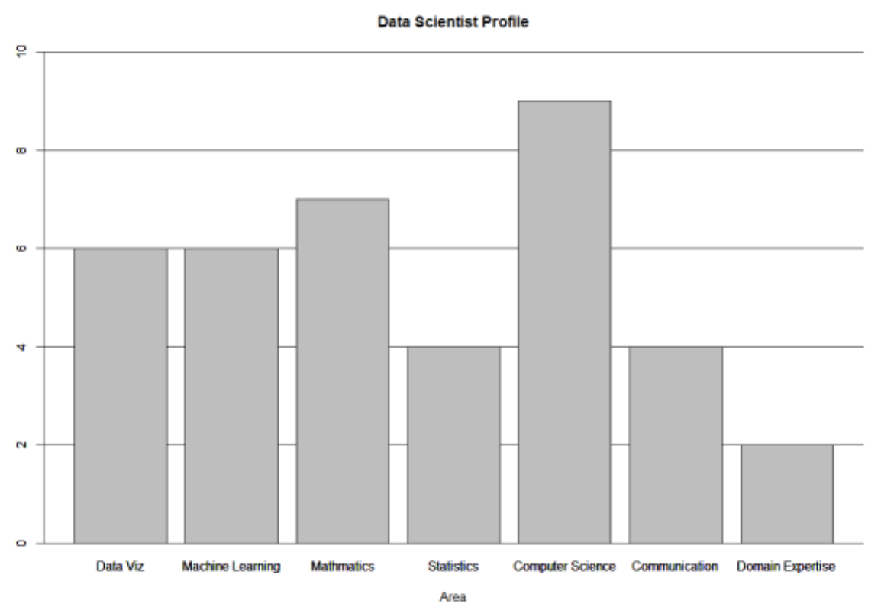
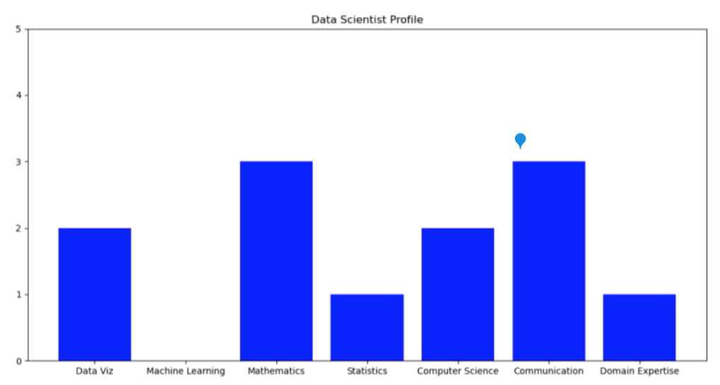
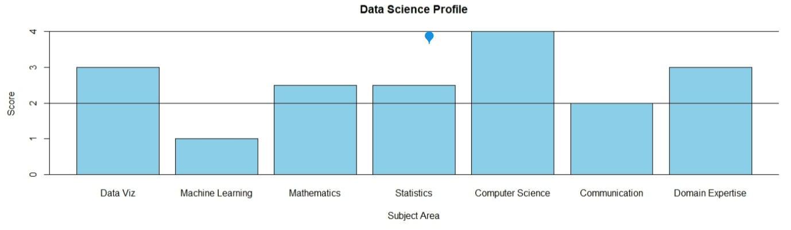
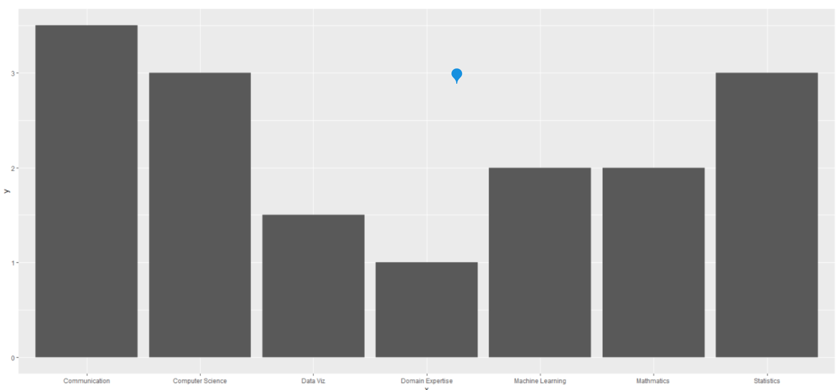
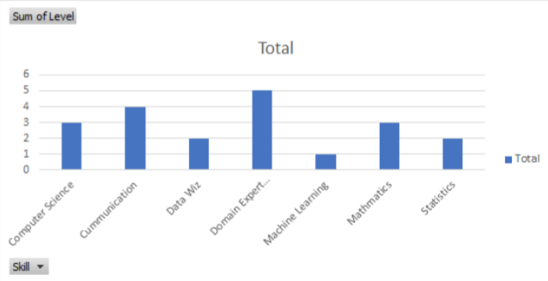
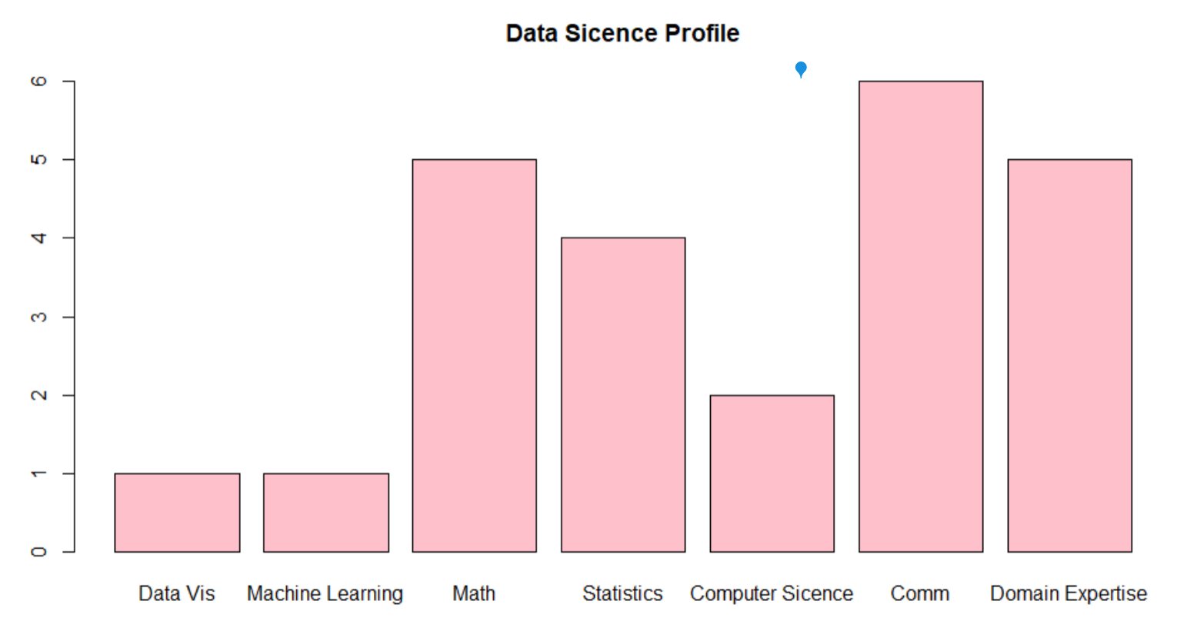
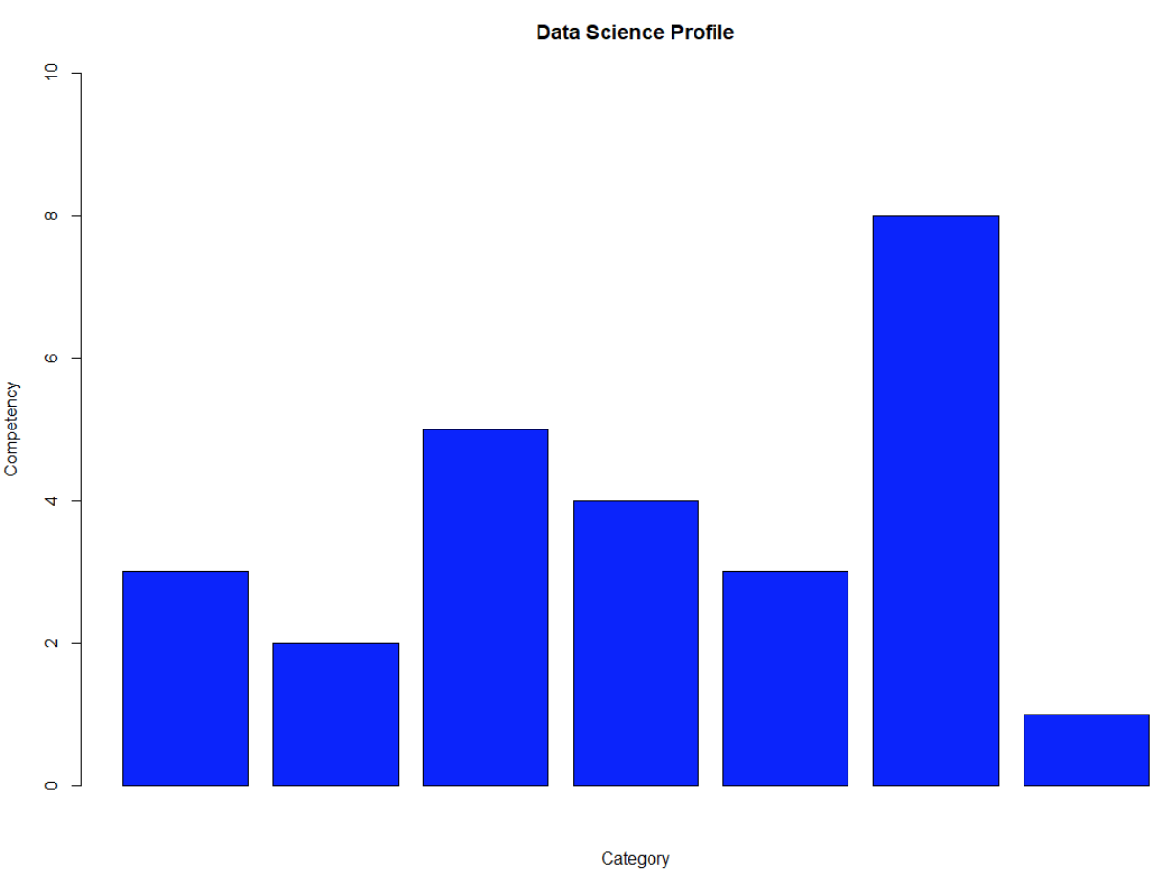
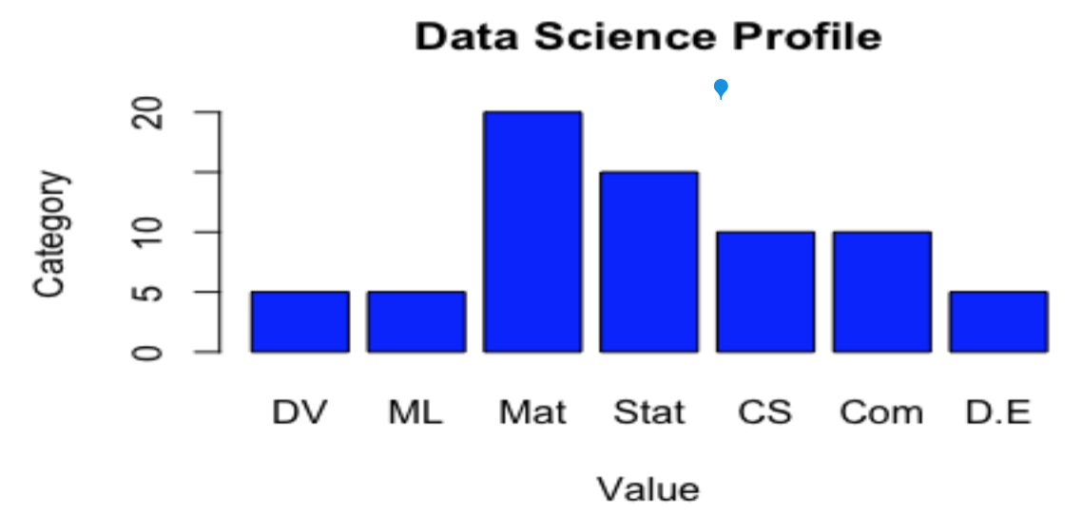
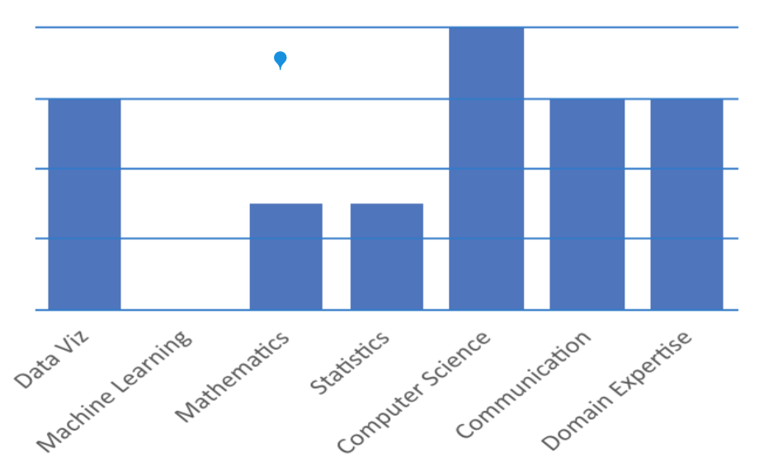
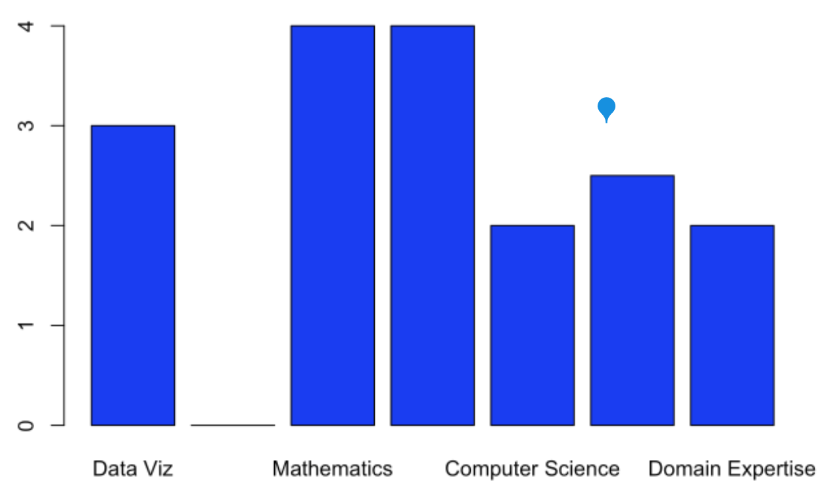
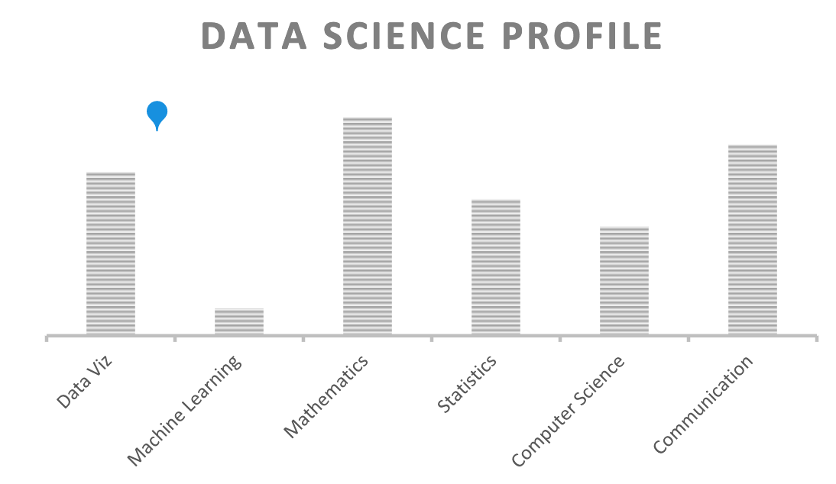
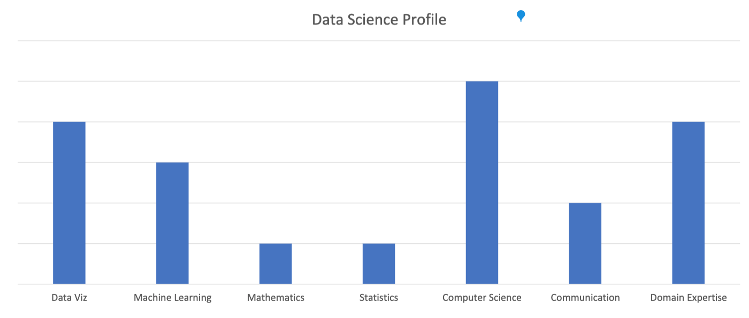
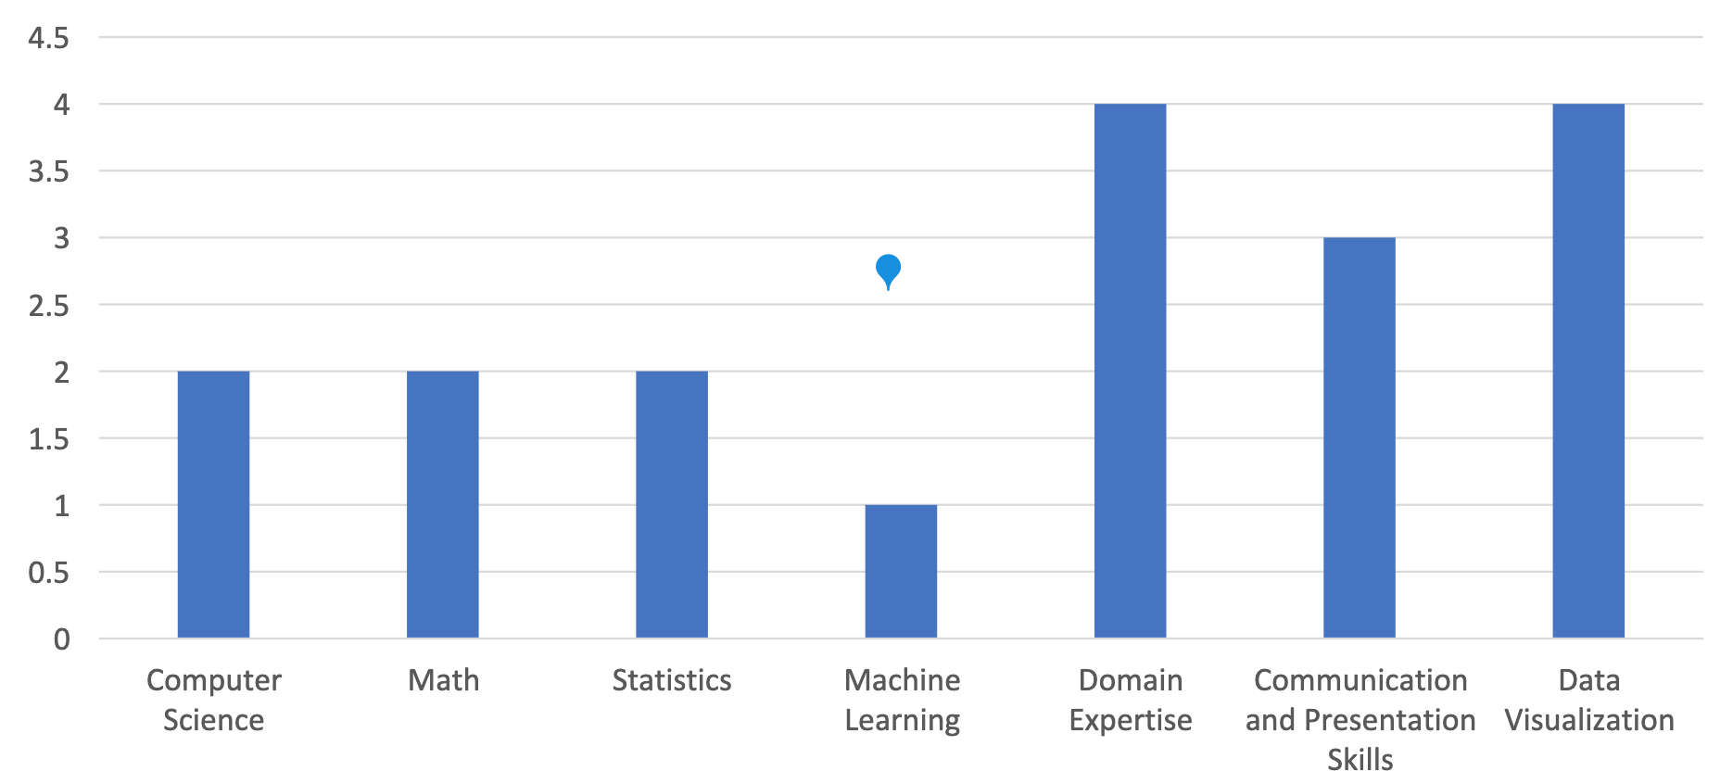
Out Data Profiles!

Slide 9
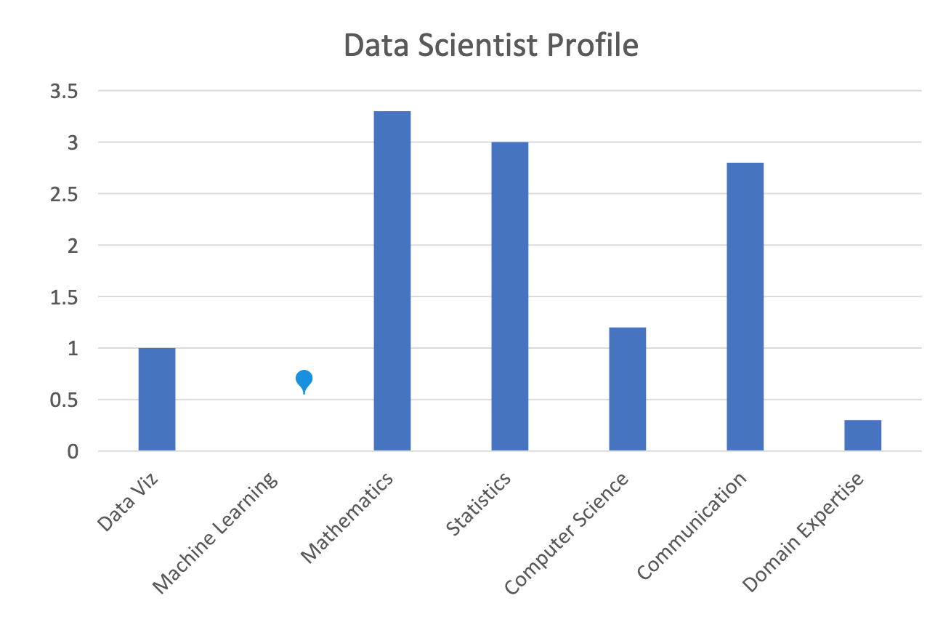
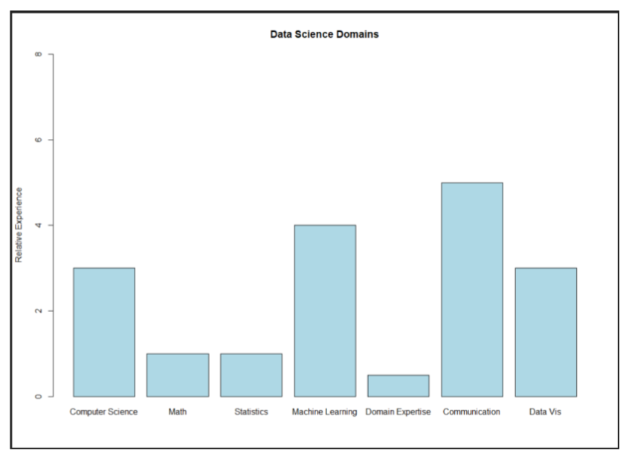
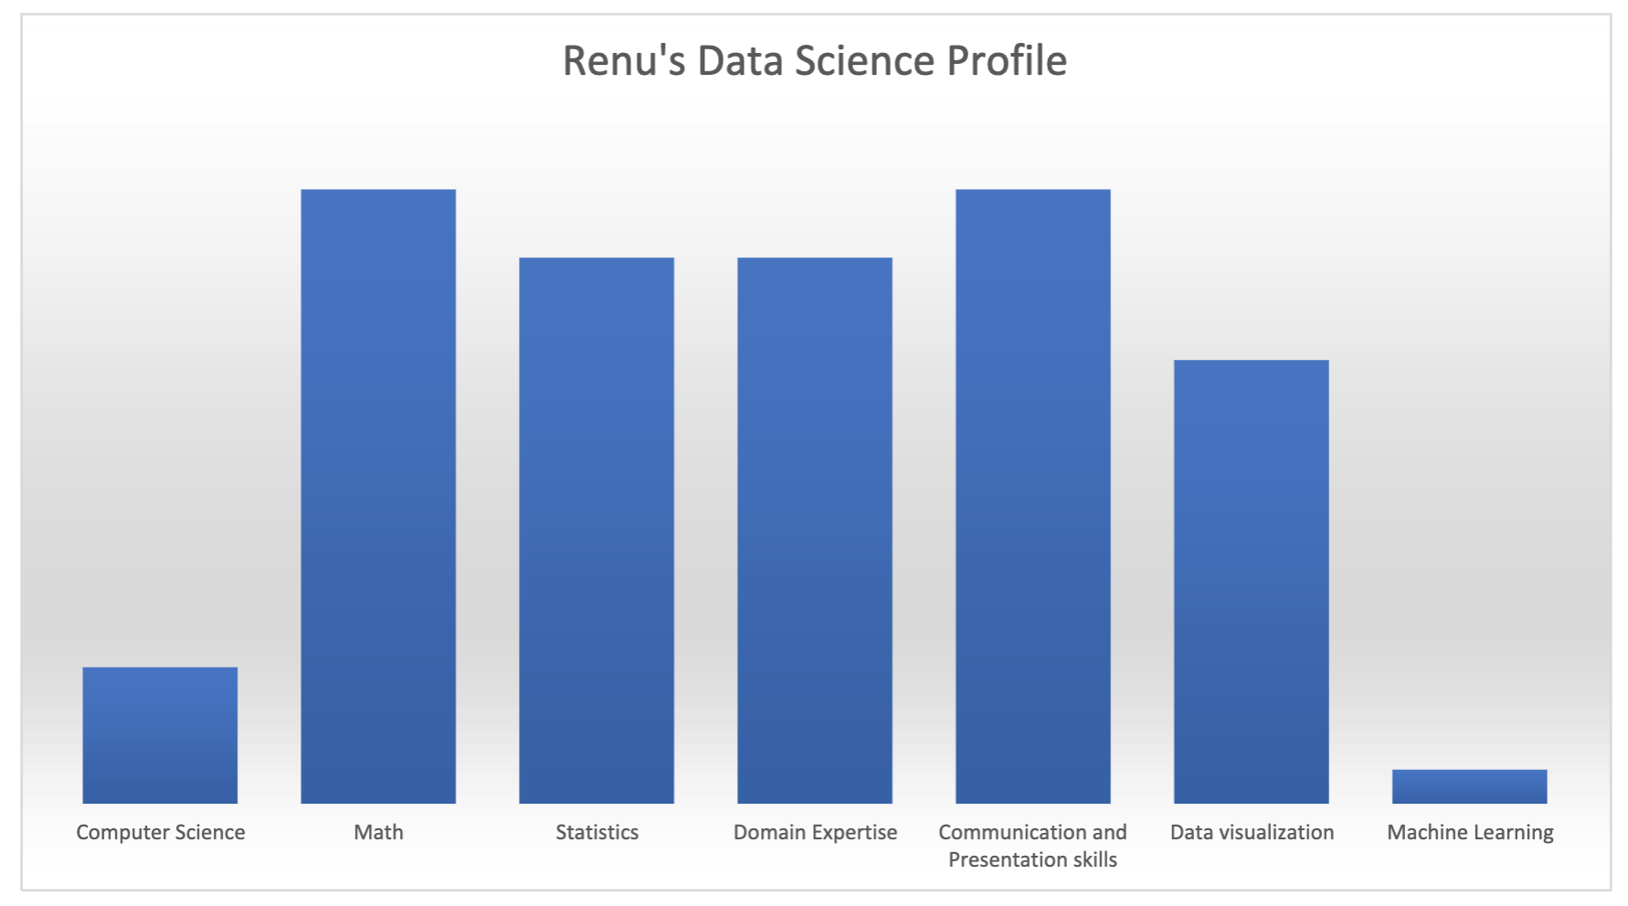
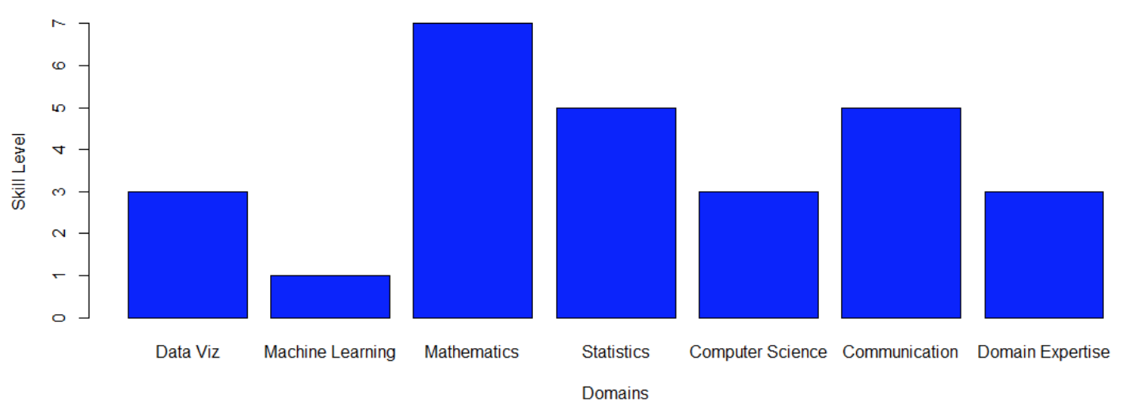
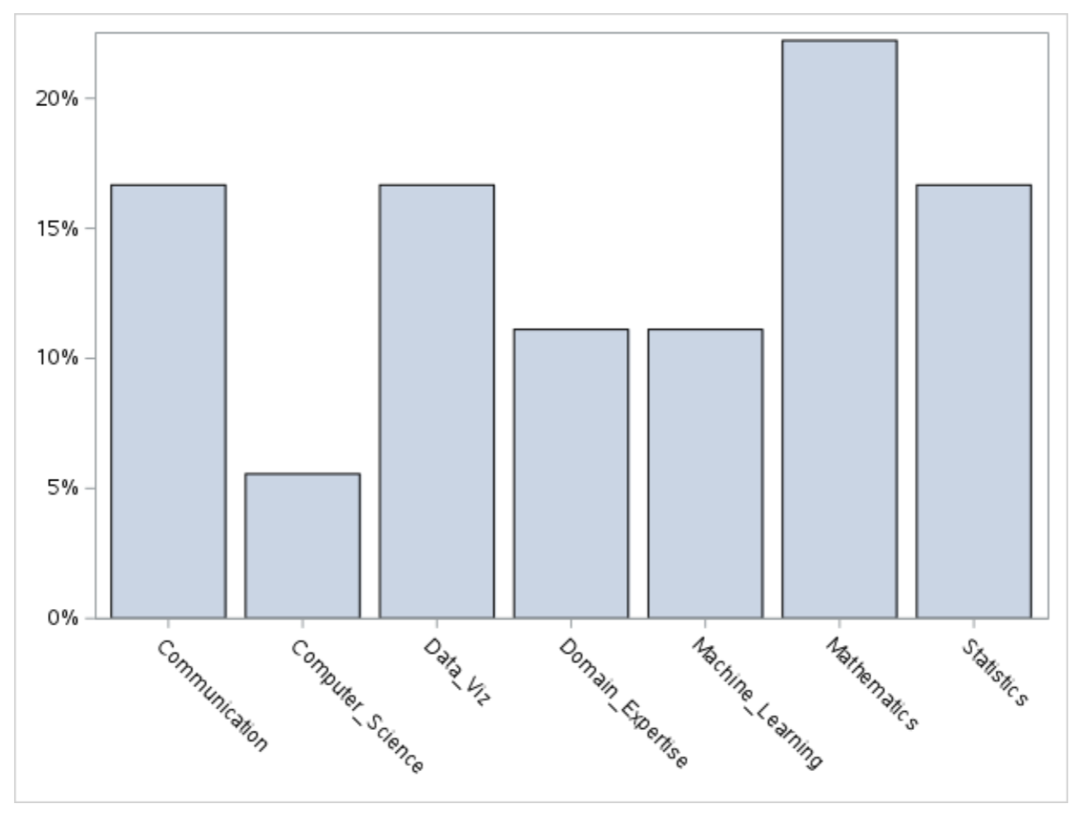
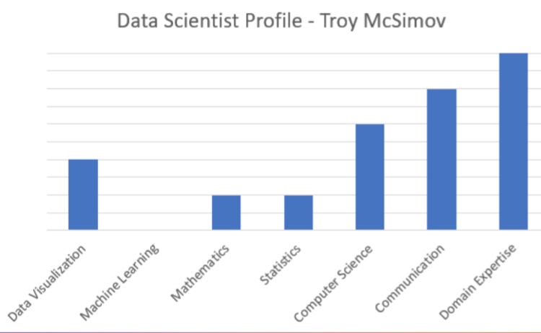
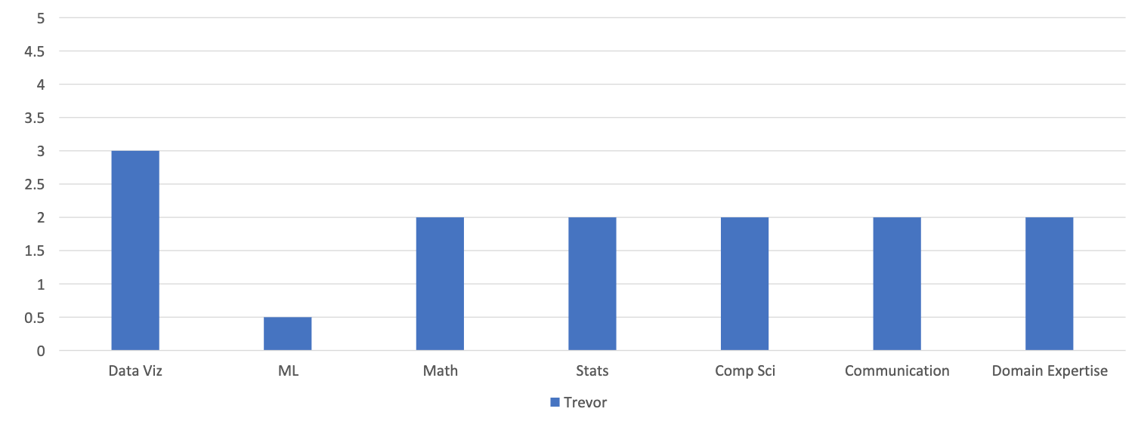
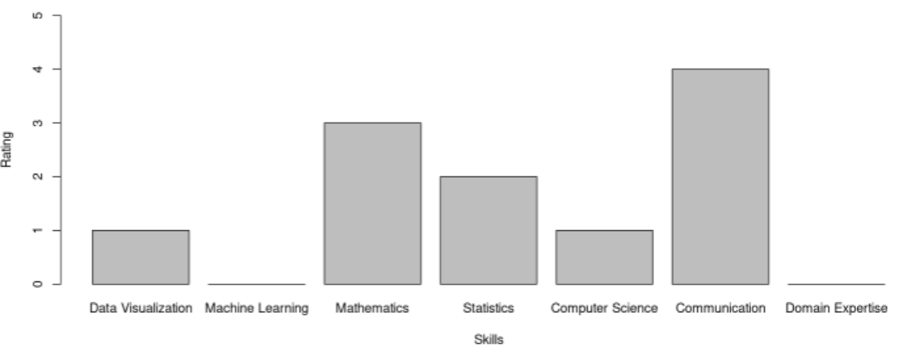
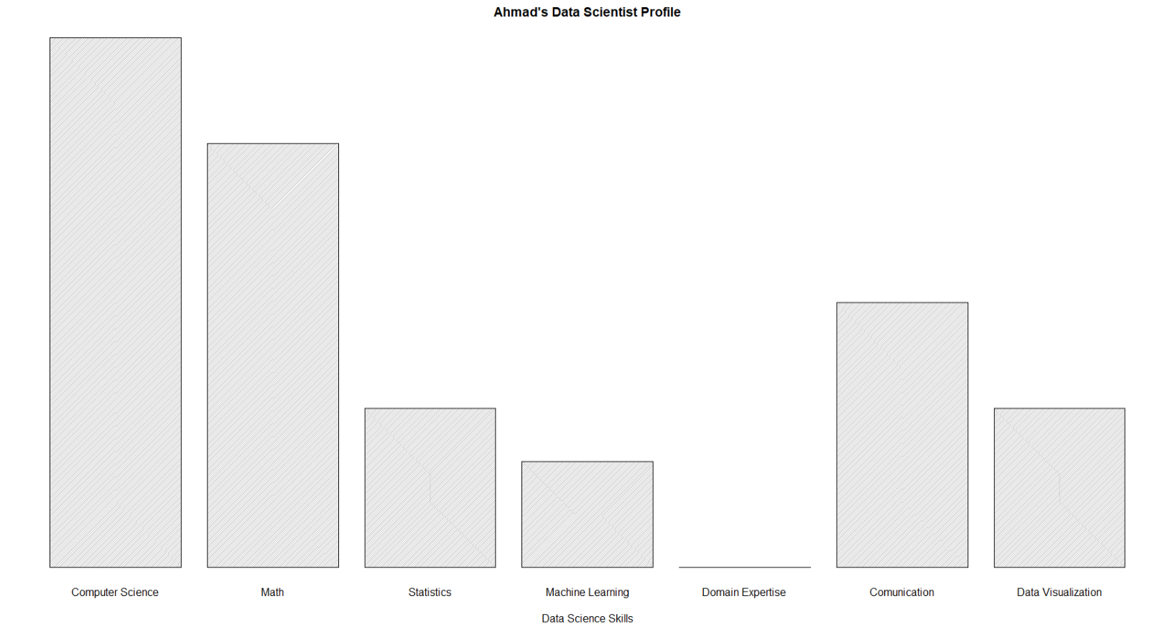
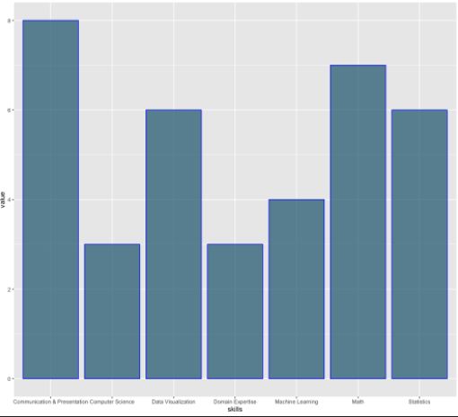



Our Data Science Profiles!

Slide 10







Our Data Science Profiles!

Slide 11

Data Science Profile 20 Year Ago

Slide 12



Data Science Profile Today!

Slide 13
For Live Session: Unit 1 Due at 1pm CST the day of live session.
For each number, provide at least 1 Powerpoint slide to provide a clear presentation of your response. You will present most of these slides in a break out and are given a score based on their completeness and clarity. Most importantly, they will maximize your live session experience!
Data Science Profile: Make a bar plot for your data science profile.
CLT: Using the central limit code from the asynch material (CLT2.Rmd), adapt the code and provide the following analysis:
Adapt the code to generate a population of 10,000,000 from a chi-square distribution with 2 degrees of freedom. This is a heavily right skewed distribution. (Hint: rchisq()). You will have to read up on this function and probably do some trial and error. Being able to learn new functions and methods is a key skill.
Provide a histogram of this population… display the right skewness.
Record the mean and standard deviation of this population.
According to the central limit theorem, what should be the approximate distribution of sample means of size 50 from this right skewed population? What should be the mean and standard error of the mean (standard deviation of the distribution of sample means)?
Now let’s check this: Adapt the CLT code to draw 10,000 means each of size 50 from this population and provide the sampling distribution of this sample mean. Provide a histogram of these 10,000 sample means.
What is the mean and standard deviation of these 10,000 sample means?
T-Test
Research in R how to conduct a T-test (t.test) and conduct a six step hypothesis test to answer the question on the next slide. If you would like to brush up on hypothesis tests, please see the Bridge Course for Statistics.
Takeaways and/or Questions: What were your key – takeaways from from this unit and what were any question or comments you would like to make? Your professor will use these to customize live session.

Slide 14

Distribution of the Population
For Internal Presentation
Client Presentation
Parameter | Value
Mean | 2.0
SD | 2.0

Slide 15
Or Better Yet….
Parameter | Value
Mean | 2.0
SD | 2.0

Slide 16

Theoretical Mean and Standard Error of the Mean
Mean of the sampling distribution of the sample mean:
μ_{xbar} = μ = 2.
Standard deviation of the sampling distribution of the sample mean (the standard error of the mean):
σ_{xbar} = $\frac{σ}{\sqrt{n}}$ = $\frac{2}{\sqrt{50}}$ = .2828

Slide 17



Confirmation from Simulation
THEORETICAL
SIMULATION
For Internal Presentation
Client Presentation
Parameter | Value
Mean | 1.998
SE | .2827

Slide 18


Slide 19
Break Out!
Create a normally distributed population of 10,000,000 subjects with mean 21 and standard deviation 7.09.
Generate the sampling distribution of the sample mean for sample means from samples of size 7.
Given this distribution, what would you call “usual” and “unusual” values? Why?

Slide 20


Slide 21

https://quarto.org/docs/faq/rmarkdown.html#:~:text=Quarto%20offers%20an%20Extension%20mechanism,logic%20behind%20custom%20metadata%20fields.

Slide 22
ChatGPT4 Solution to CLT Exercise

Slide 23


ChatGPT4 Solution to CLT Exercise
CLT: Using the central limit code from the asynch material (CLT2.Rmd), adapt the code and provide the following analysis:
Adapt the code to generate a population of 10,000,000 from a chi-square distribution with 2 degrees of freedom. This is a heavily right skewed distribution. (Hint: rchisq()). You will have to read up on this function and probably do some trial and error. Being able to learn new functions and methods is a key skill.
Provide a histogram of this population… display the right skewness.
Record the mean and standard deviation of this population.
# set seed for reproducibility
set.seed(123)
# generate 10,000,000 values from a chi-square
# distribution with 2 degrees of freedom
population <- rchisq(n = 10000000, df = 2)
# plot a histogram of the population
hist(population, breaks = 100, col = "gray", main = "Chi-square Distribution with 2 Degrees of Freedom")
# calculate the mean and standard deviation of the population
mean_population <- mean(population)
sd_population <- sd(population)
# print the results
cat("Mean of population:", mean_population, "\n")
cat("Standard deviation of population:", sd_population, "\n")

Slide 24


ChatGPT4 Solution to CLT Exercise
CLT: Using the central limit code from the asynch material (CLT2.Rmd), adapt the code and provide the following analysis:
Adapt the code to generate a population of 10,000,000 from a chi-square distribution with 2 degrees of freedom. This is a heavily right skewed distribution. (Hint: rchisq()). You will have to read up on this function and probably do some trial and error. Being able to learn new functions and methods is a key skill.
Provide a histogram of this population… display the right skewness.
Record the mean and standard deviation of this population.
According to the central limit theorem, what should be the approximate distribution of sample means of size 50 from this right skewed population? What should be the mean and standard error of the mean (standard deviation of the distribution of sample means)?

Slide 25

ChatGPT4 Solution to CLT Exercise
CLT: Using the central limit code from the asynch material (CLT2.Rmd), adapt the code and provide the following analysis:
Adapt the code to generate a population of 10,000,000 from a chi-square distribution with 2 degrees of freedom. This is a heavily right skewed distribution. (Hint: rchisq()). You will have to read up on this function and probably do some trial and error. Being able to learn new functions and methods is a key skill.
Provide a histogram of this population… display the right skewness.
Record the mean and standard deviation of this population.
According to the central limit theorem, what should be the approximate distribution of sample means of size 50 from this right skewed population? What should be the mean and standard error of the mean (standard deviation of the distribution of sample means)?
Now let’s check this: Adapt the CLT code to draw 10,000 means each of size 50 from this population and provide the sampling distribution of this sample mean. Provide a histogram of these 10,000 sample means.
# set seed for reproducibility
set.seed(123)
# draw 10,000 samples of size 50 from the population
n_samples <- 10000
sample_size <- 50
samples <- matrix(rchisq(n_samples * sample_size, df = 2), ncol = sample_size)
# calculate the mean of each sample
sample_means <- apply(samples, 1, mean)
# plot a histogram of the sample means
hist(sample_means, breaks = 100, col = "gray", main = "Sampling Distribution of Sample Means")

Slide 26

ChatGPT4 Solution to CLT Exercise
CLT: Using the central limit code from the asynch material (CLT2.Rmd), adapt the code and provide the following analysis:
Adapt the code to generate a population of 10,000,000 from a chi-square distribution with 2 degrees of freedom. This is a heavily right skewed distribution. (Hint: rchisq()). You will have to read up on this function and probably do some trial and error. Being able to learn new functions and methods is a key skill.
Provide a histogram of this population… display the right skewness.
Record the mean and standard deviation of this population.
According to the central limit theorem, what should be the approximate distribution of sample means of size 50 from this right skewed population? What should be the mean and standard error of the mean (standard deviation of the distribution of sample means)?
Now let’s check this: Adapt the CLT code to draw 10,000 means each of size 50 from this population and provide the sampling distribution of this sample mean. Provide a histogram of these 10,000 sample means.
What is the mean and standard deviation of these 10,000 sample means?
# calculate the mean and standard deviation of the sample means
mean_sample_means <- mean(sample_means)
sd_sample_means <- sd(sample_means)
# print the results
cat("Mean of sample means:", mean_sample_means, "\n")
cat("Standard deviation of sample means:", sd_sample_means, "\n")

Slide 27

ChatGPT4 Solution to CLT Exercise
CLT: Using the central limit code from the asynch material (CLT2.Rmd), adapt the code and provide the following analysis:
Adapt the code to generate a population of 10,000,000 from a chi-square distribution with 2 degrees of freedom. This is a heavily right skewed distribution. (Hint: rchisq()). You will have to read up on this function and probably do some trial and error. Being able to learn new functions and methods is a key skill.
Provide a histogram of this population… display the right skewness.
Record the mean and standard deviation of this population.
According to the central limit theorem, what should be the approximate distribution of sample means of size 50 from this right skewed population? What should be the mean and standard error of the mean (standard deviation of the distribution of sample means)?
Now let’s check this: Adapt the CLT code to draw 10,000 means each of size 50 from this population and provide the sampling distribution of this sample mean. Provide a histogram of these 10,000 sample means.
What is the mean and standard deviation of these 10,000 sample means?
# calculate the mean and standard deviation of the sample means
mean_sample_means <- mean(sample_means)
sd_sample_means <- sd(sample_means)
# print the results
cat("Mean of sample means:", mean_sample_means, "\n")
cat("Standard deviation of sample means:", sd_sample_means, "\n")

Slide 28





ChatGPT4

Slide 29

1 Hypothesis Test
The following are ages of 7 randomly chosen patrons seen leaving the Beach Comber in South Mission Beach at 7pm! We assume that the data come from a normal distribution and would like to test the claim that the mean age of the distribution of Comber patrons is different than 21. Conduct a 6 step hypothesis test to test this claim.
25, 19, 37, 29, 40, 28, 31

Slide 30
Strategy of Hypothesis Testing
1. Make an Assumption
2. Gather Evidence
3. Calculate the probability that we would observe this evidence IF ASSUMPTION IS TRUE.
4. Make a decision…. If it is very unlikely we would observe the evidence we observed if the assumption were true then this is evidence AGAINST this assumption’s truth and we will decide the assumption is false. However, if the evidence is consistent with the assumption we made then we cannot conclude (decide) that the assumption is false.

Slide 32

Run through R markdown code.
-2.445
0
2.445
3.3

Slide 33
Strategy of Hypothesis Testing
1. Make an Assumption (Ho)
2. Gather Evidence (data, xbar)
3. Calculate the probability that we would observe this evidence IF ASSUMPTION IS TRUE. (The Pvalue!)
Make a decision….
If it is very unlikely we would observe the evidence we observed if the assumption were true then this is evidence AGAINST this assumption’s truth and we will decide the assumption is false. (Reject the assumption … Reject Ho.)
However, if the evidence is consistent with the assumption we made then we cannot conclude (decide) that the assumption is false. (Fail to Reject the assumption … Fail to Reject Ho.)

Slide 34
1 Hypothesis Test
The following are ages of 7 randomly chosen patrons seen leaving the Beach Comber in South Mission Beach at 7pm! We assume that the data come from a normal distribution and would like to test the claim that the mean age of the distribution of Comber patrons is different than 21. Conduct a 6 step hypothesis test to test this claim.
25, 19, 37, 29, 40, 28, 31

Slide 35






Revised Write Up!
We would like to test the claim that the population mean is greater than $4.$ To do this we take a sample of size n = 8 and find that $\overline{x}$ = 29.86 years and s = 7.09 years.
Ho: $µ=21$
Ha: $µ≠21$
Step 1: Identify the null (Ho) and alternative (Ha) hypothesis.
Step 2: Draw and Shade and Find the Critical Value.
$$t=\frac{\overline{x}−μ}{\frac{s}{\sqrt{n}}}$$
$$=\frac{29.86−21}{\frac{7.09}{\sqrt{7}}}$$
$$=3.31$$
Step 3: Find the test statistic. (The t value for the data.)
Step 4: Find the pvalue: Pvalue = .0162 < .05
Step 5: REJECT HO
Step 6: There is strong evidence to conclude that the true mean age of patrons at the Comber at 7pm is greater than 21 (pvalue =.0162 from a t-test).

Slide 36


Revised Write Up!
We would like to test the claim that the population mean is greater than $4.$ To do this we take a sample of size n = 8 and find that $\overline{x}$ = 29.86 years and s = 7.09 years.
Ho: $µ=21$
Ha: $µ≠21$
Step 1: Identify the null (Ho) and alternative (Ha) hypothesis.
Step 2: Draw and Shade and Find the Critical Value.
$$t=\frac{\overline{x}−μ}{\frac{s}{\sqrt{n}}}$$
$$=\frac{29.86−21}{\frac{7.09}{\sqrt{7}}}$$
$$=3.31$$
Step 3: Find the test statistic. (The t value for the data.)
Step 4: Find the pvalue: Pvalue = .0162 < .05
Step 5: REJECT HO
Step 6: There is strong evidence to conclude that the true mean age of patrons at the Comber at 7pm is greater than 21 (pvalue =.0162 from a t-test). We are 95% confident that this mean age is between 23.3 years and 36.4 years.

Slide 37

ChatGPT and the Big Picture

Slide 38
Answer to Break Out 2 Review the T-Test

Slide 39
CLT and the Beachcomber Problem
In your Breakout Group:
Adapt the CLT code generate sample means from a normal distribution with mean 28 and standard deviation 7 years.
Run another T-Test, this time testing the null hypothesis that the true mean age of patrons at the beach comber is 28. Does the pvalue reflect what you found in your simulation?
Repeat the above again for a true mean of 30. Does the CLT and the T-Test suggest that the data are consistent or inconsistent with a true mean age of patrons being 30?
Your client just asked you how are the CLT and T-Test are related? How do you respond?

Slide 40
So Important!!! Takeaways and Questions!!!

